Slide 1
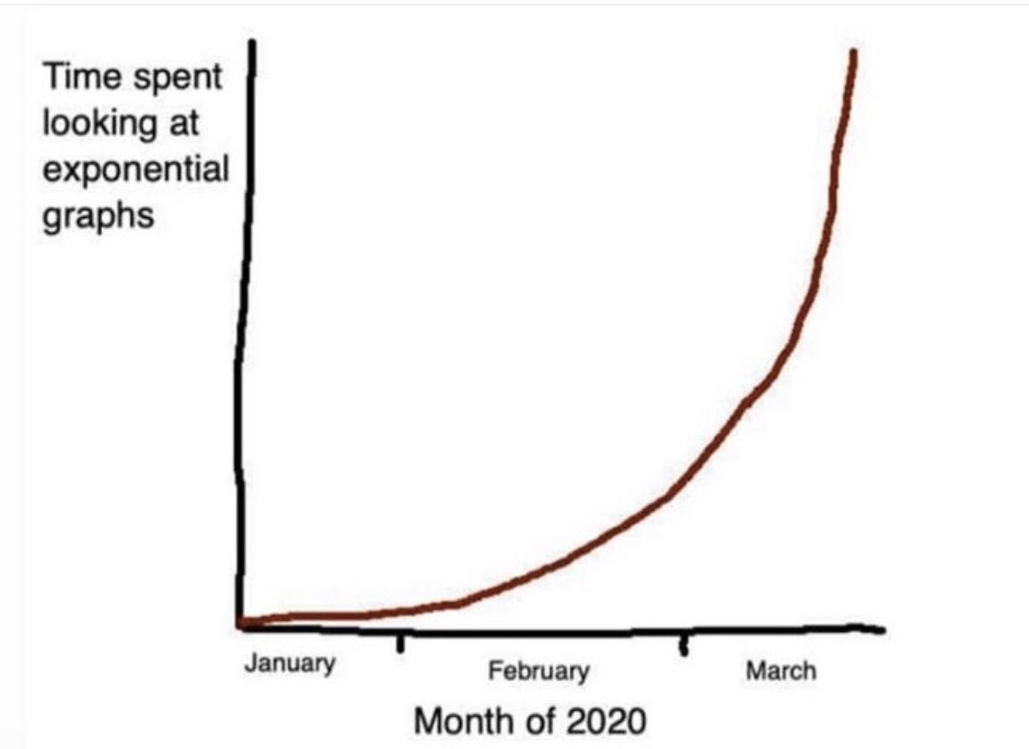
Epidemiology of SARS-CoV-2 Infection
Michael Z. Levy
Associate Professor Dept. of Biostatistics, Epidemiology & Informatics
University of Pennsylvania
mzlevy@upenn.edu
The internet

Slide 2
Mathematical Models of the Epidemic
Such calculations…are useful, not so much for the numerical estimates yielded by them, but because they give more precision to our ideas, and a guide for future investigations.
Ronald Ross, 1910

Slide 3
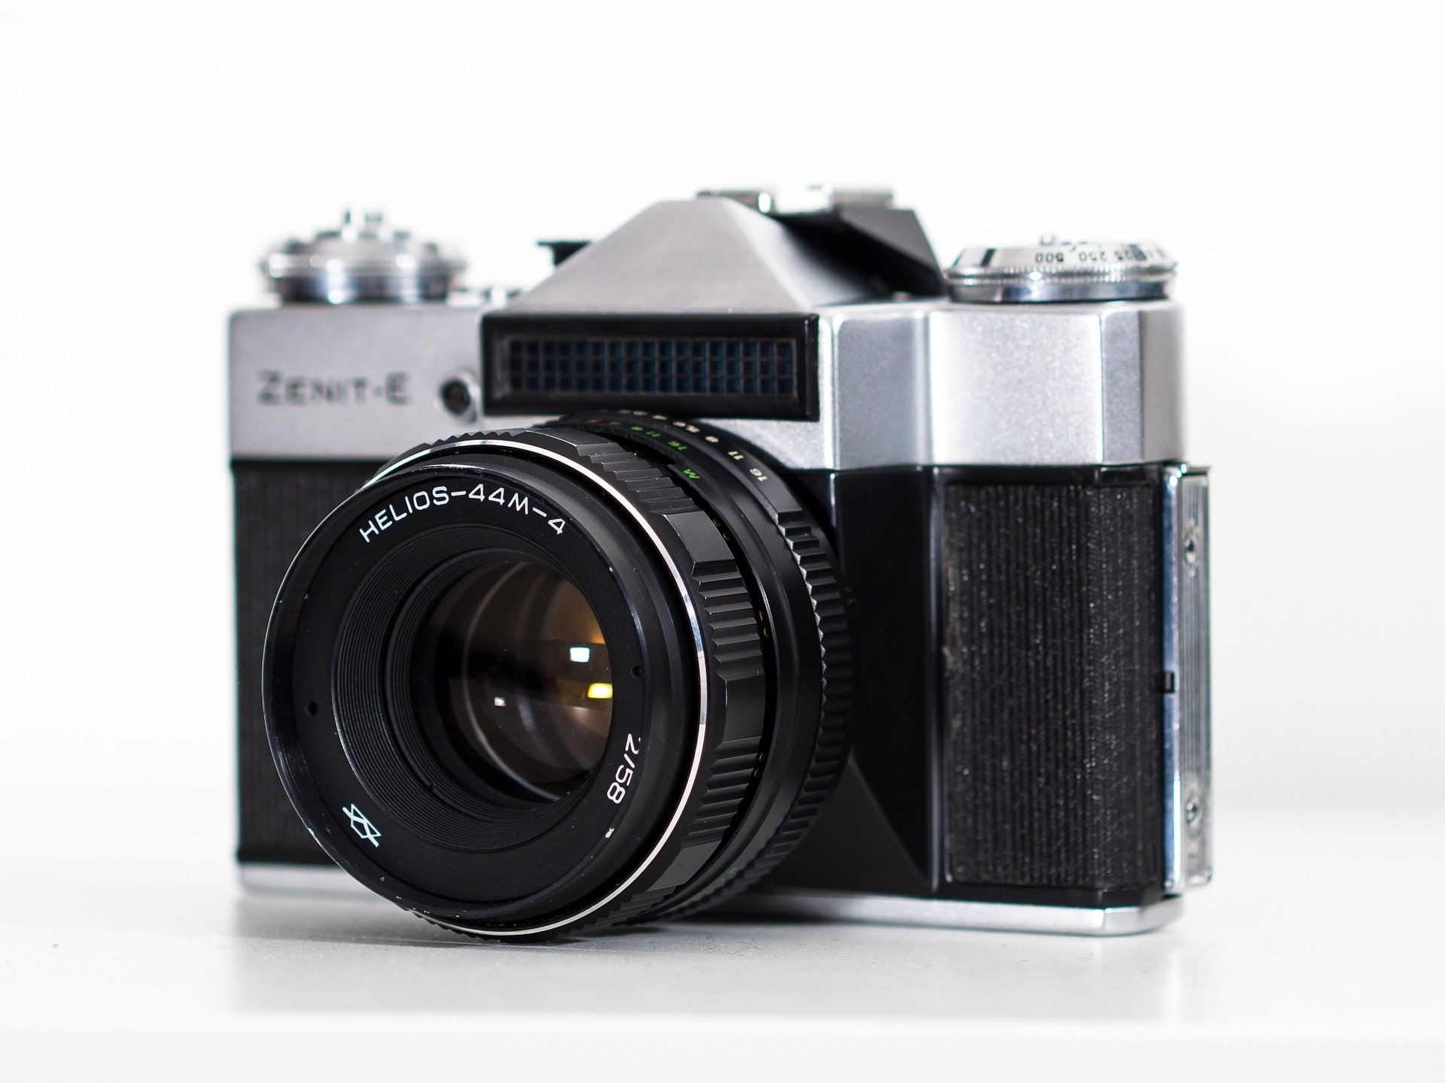
Mathematical Models of the Epidemic
Such calculations…are useful, not so much for the numerical estimates yielded by them, but because they give more precision to our ideas, and a guide for future investigations.
Ronald Ross, 1910
A model is like a lens

Slide 4
Mathematical Models of the Epidemic
Such calculations…are useful, not so much for the numerical estimates yielded by them, but because they give more precision to our ideas, and a guide for future investigations.
Ronald Ross, 1910
A model is like a lens
A computer is a pensieve

Slide 5
Mathematical Models of the Epidemic
Susceptible
Infectious
Recovered
S
I
R
Notes:
Canonical model - splits population into susceptible infectious and recovered

Slide 6
The early epidemic is exponential
Susceptible
Infectious
Recovered
S
I
R

Slide 7
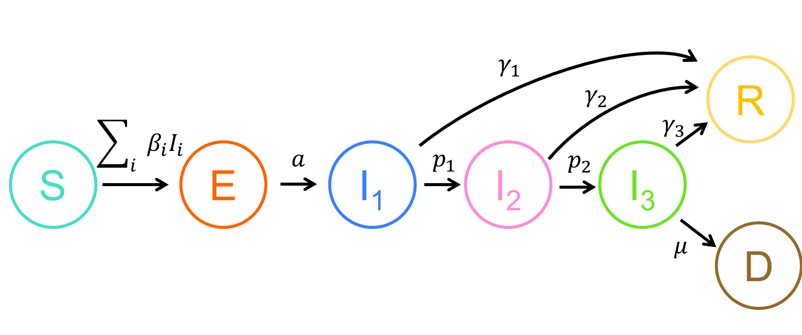
The early Dynamics—How many hospitalized? How many in the ICU?
Infectious
Recovered
Exposed
Susceptible
Deceased

Slide 8
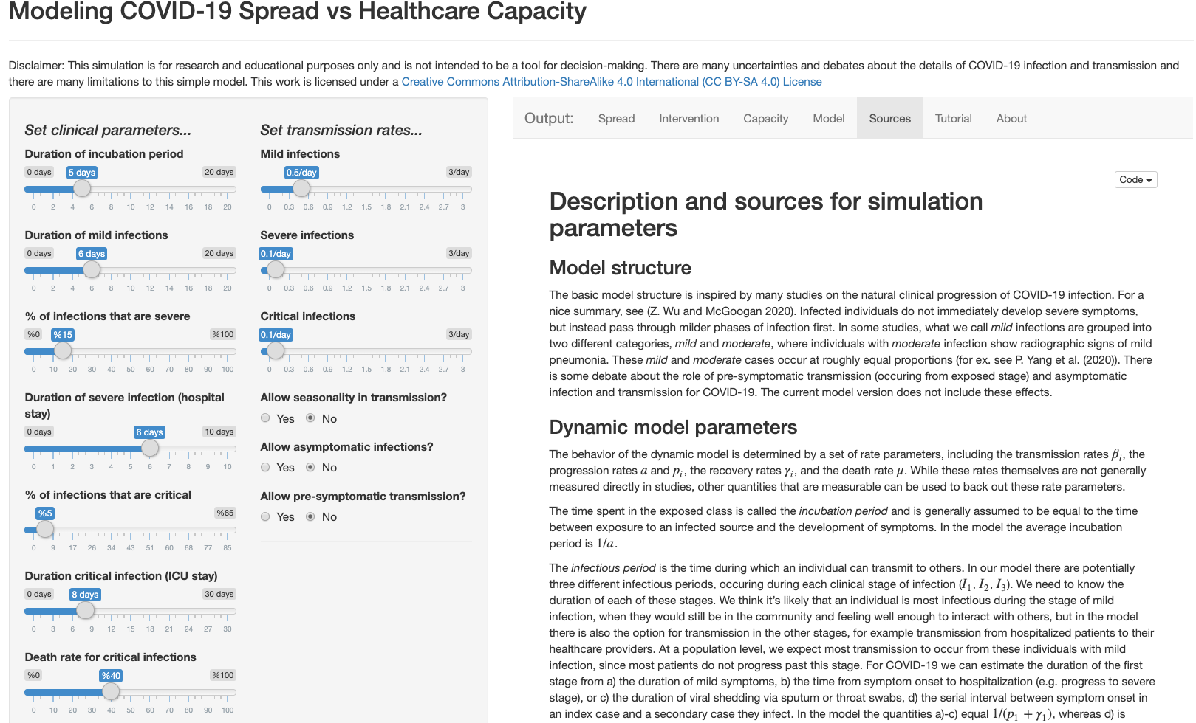
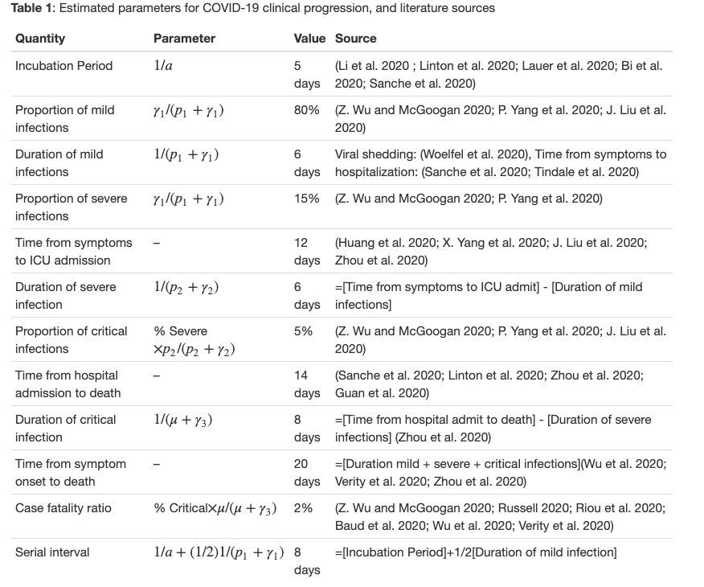
The early Dynamics—How many hospitalized? How many in the ICU?
Parameterize
https://alhill.shinyapps.io/COVID19seir/
Alison Hill & Team

Slide 9
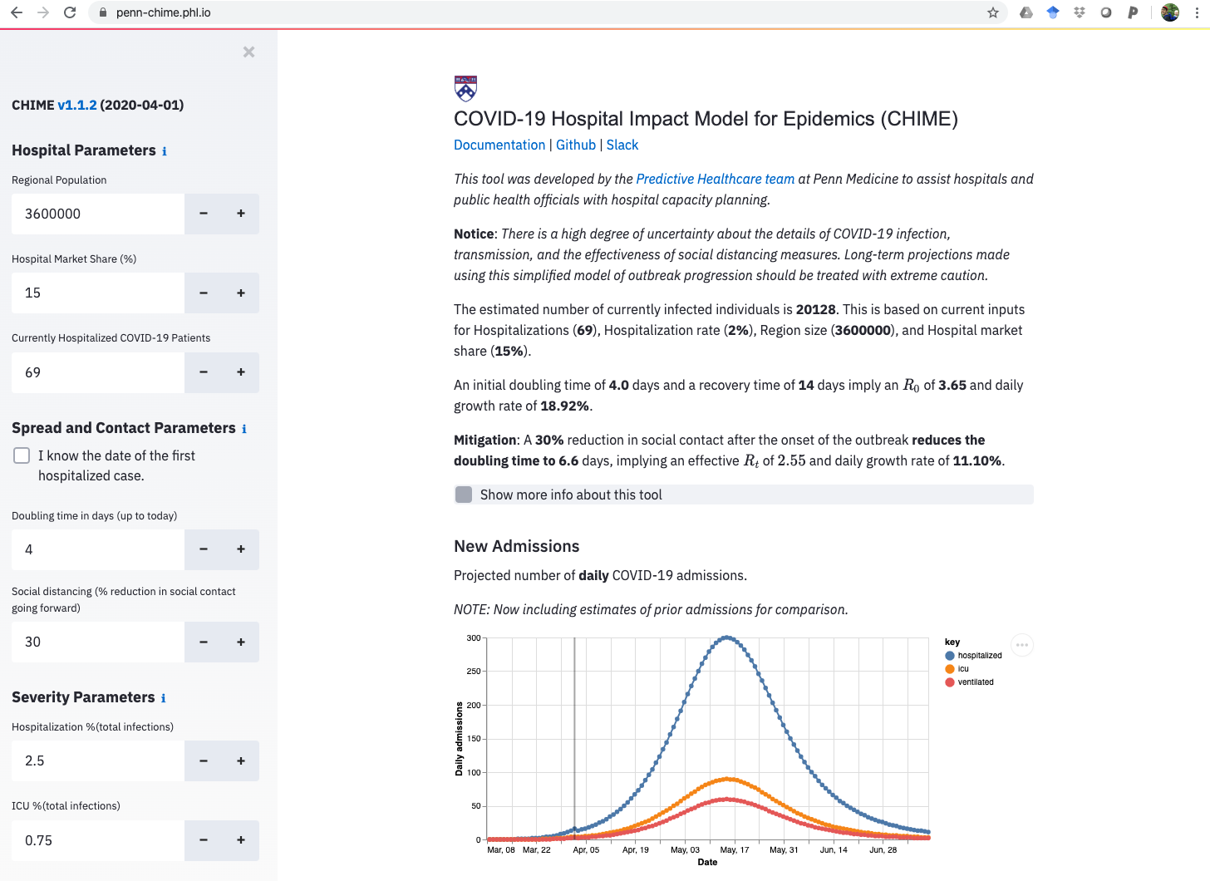
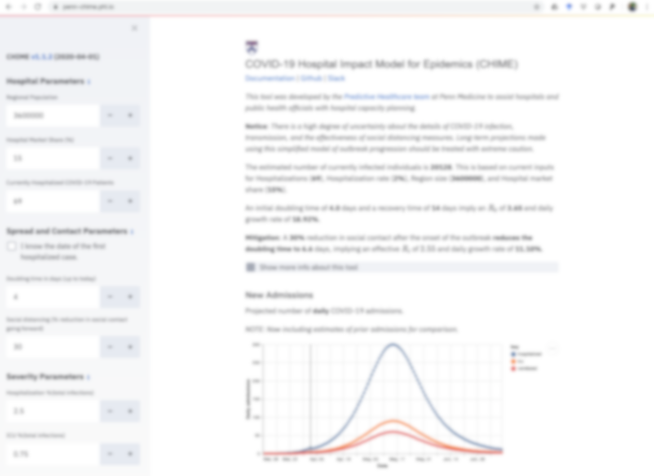
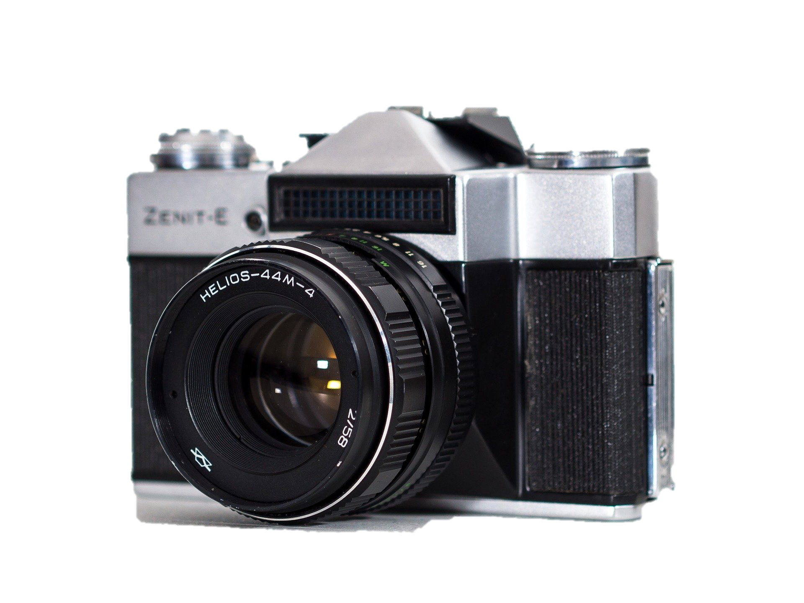
The early Dynamics—How many hospitalized? How many in the ICU?
Corey Chivers & Chime Team

Slide 10
The basic SIR models use mass action to model contact--everyone is alike--perfect spheres in a vacuum. They are very egalitarian. But we don't interact like perfect spheres in a vacuum, especially now.

Slide 11
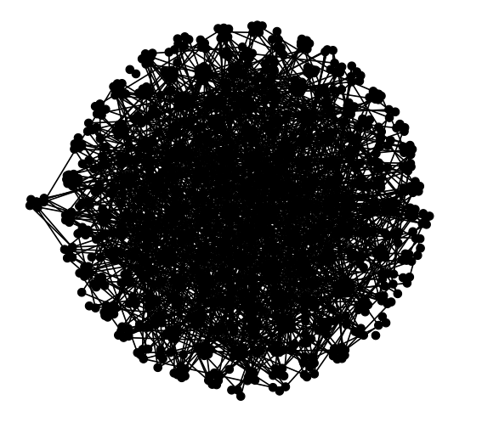
SIR models can be misleading on Social Distancing
Network models reveal the effects of the variation in how connected we are to one another. These will generally predict a smaller epidemic, one in which those who are more connected are more likely to be infected, and those more isolated to be spared.

Slide 12
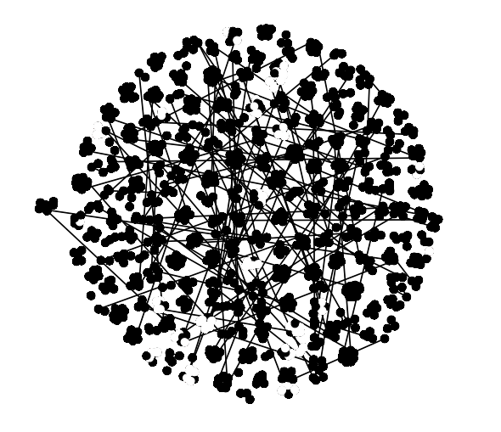
SIR models can be misleading on Social Distancing
Social Distancing decreases contacts between households
With social distancing
Notes:
Here’s how I think about social distancing—many of us clumped in our homes, some still going out

Slide 13
SIR models can be misleading on Social Distancing
Social Distancing decreases contacts between households, but not within households
Mode of Contact | Total (of 4950) | + | %
Public Transport | 818 | 1 | 0.1%
Healthcare settings | 679 | 7 | 1.0%
Households | 946 | 96 | 10.2%
Luo et al Modes of contact and risk of transmission in COVID-19 among close contacts
With social distancing
Notes:
Here’s how I think about social distancing—many of us clumped in our homes, some still going out

Slide 14
SIR models can be misleading on Social Distancing
It will take an extra ‘serial interval’ to see the effects of social distancing
The chains of transmission already in course will play out within our homes.
Mode of Contact | Total (of 4950) | + | %
Public Transport | 818 | 1 | 0.1%
Healthcare settings | 679 | 2 | 1.0%
Households | 946 | 96 | 10.2%
Luo et al Modes of contact and risk of transmission in COVID-19 among close contacts
With social distancing
Notes:
Here’s how I think about social distancing—many of us clumped in our homes, some still going out

Slide 15
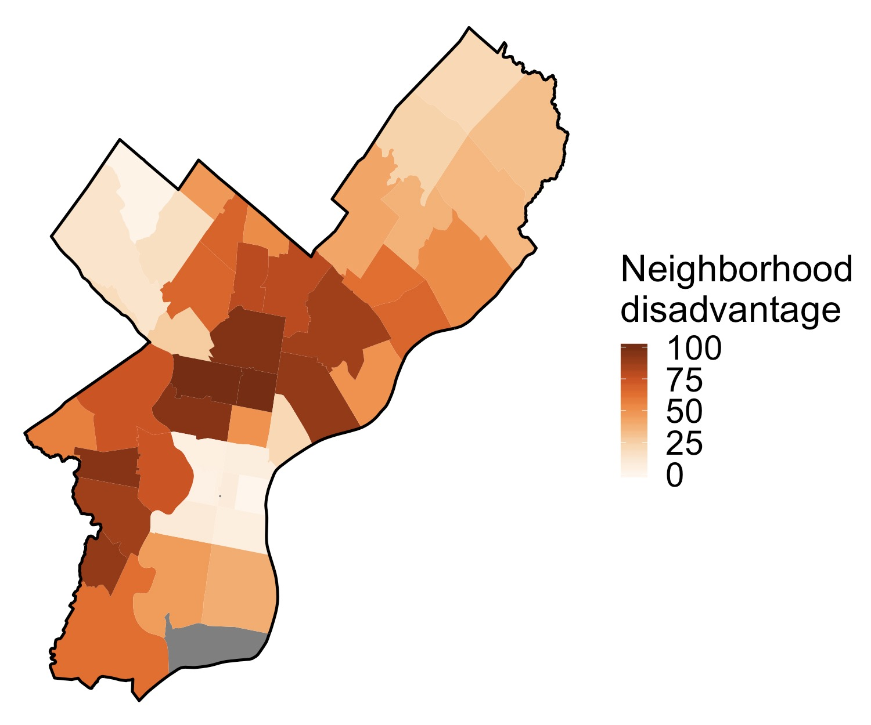
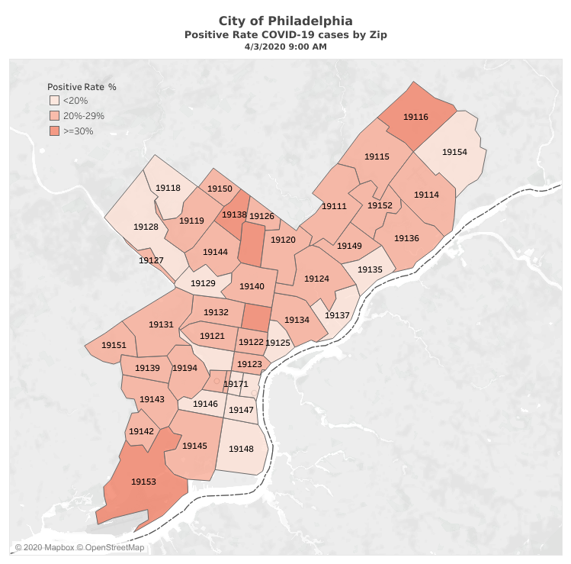
What’s going on in Philly?
‘Neighborhood disadvantage'
Proportion of positive tests 4/3/9am
Sources: American Community Survey (ACS) 5-year Estimates for 2014-2018; City of Philadelphia COVID-19 test results from April 2, 2020
https://www.phila.gov/programs/coronavirus-disease-2019-covid-19/the-citys-response/monitoring-and-testing/
Slide by Sherrie Xie PhDc

Slide 16
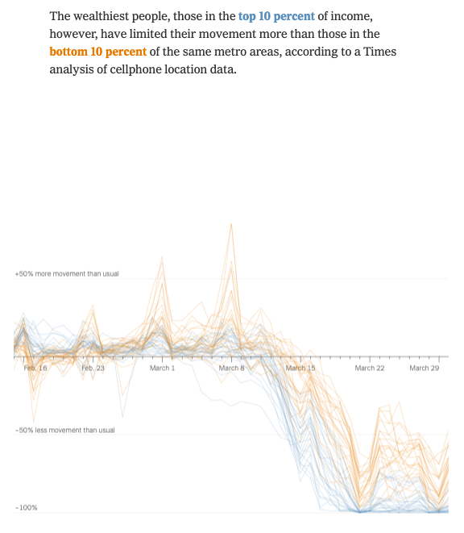
Social Distancing and Social Justice
With social distancing
Valentino-DeVries et al. nytimes
Notes:
Here’s how I think about social distancing—many of us clumped in our homes, some still going out

Slide 17
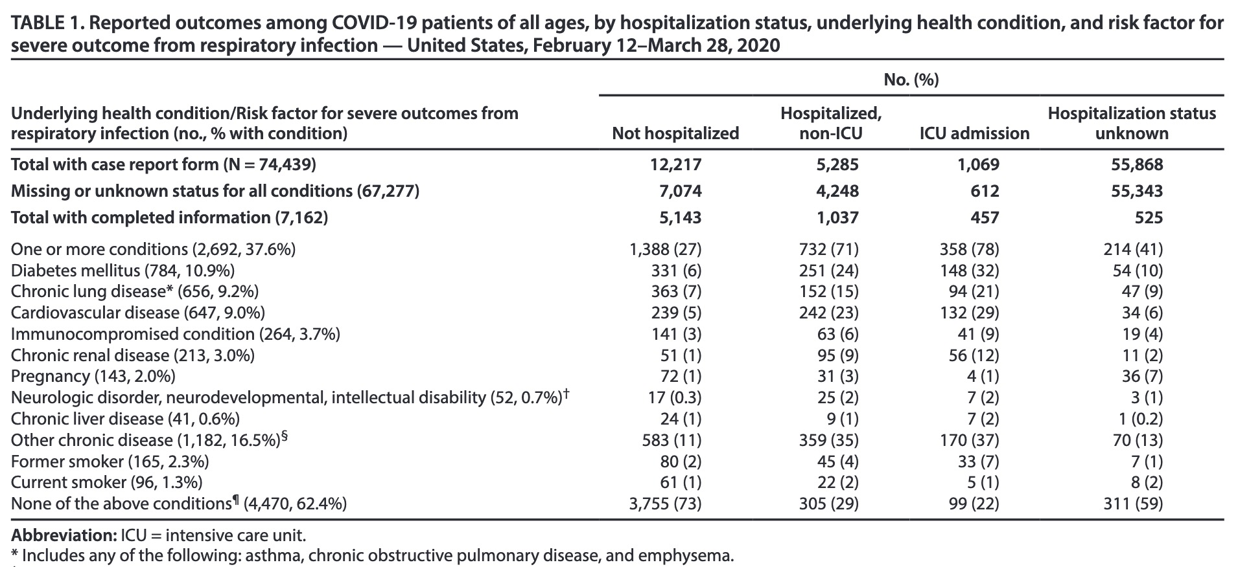
Social Distancing and Social Justice
Underlying health conditions are associated with hospitalization/ICU admission for COVID-19 in the U.S.
Source: CDC MMWR for Mar 31, 2020 https://www.cdc.gov/mmwr/volumes/69/wr/pdfs/mm6913e2-H.pdf

Slide 18
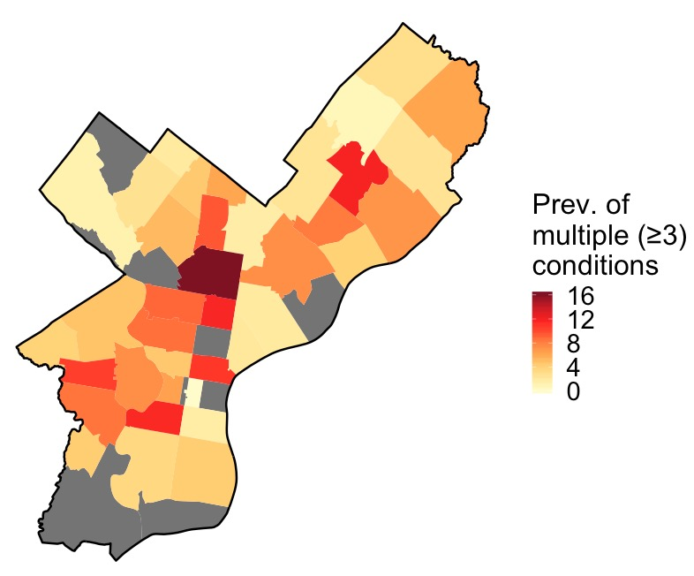
What’s going on in Philly?
Multiple Health Conditions
Proportion of positive COVID-19 4/3/9am
Source: Public Health Management Corporation (PHMC) Southeastern Pennsylvania Household Health Survey, 2018 – grey—too little data
https://www.phila.gov/programs/coronavirus-disease-2019-covid-19/the-citys-response/monitoring-and-testing/
Slide by Sherrie Xie PhDc

Slide 19
When is it going to stop?
We don’t know
We need to carefully quantify the effect of social distancing on the appropriate scale.
Methods are being made up on the fly.
Notes:
Here’s how I think about social distancing—many of us clumped in our homes, some still going out

Slide 20
Will a drug stop it?
No.
Drugs in trial might save lives but they aren’t going to have a large effect on transmission
Drugs hopefully
reduce these
rates
Some drugs in trial
Remdesivir: intravenous infusion
Hyddrochloroquine: pill
chloroquine: IM or injection, pill
lopanivir/ritonavir (Kaletra): pill
sarilumab: subcutaneous injection
tocilixumab: IV infusion
Notes:
Here’s how I think about social distancing—many of us clumped in our homes, some still going out

Slide 21
Will a drug stop it?
No.
Drugs in trial might save lives but they aren’t going to have a large effect on transmission
But they aren’t
likely to help
on these rates
Drugs hopefully
reduce these
rates
Some drugs in trial
Remdesivir: intravenous infusion
Hydrochloroquine: pill
chloroquine: IM or injection, pill
lopanivir/ritonavir (Kaletra): pill
sarilumab: subcutaneous injection
tocilixumab: IV infusion
Notes:
Here’s how I think about social distancing—many of us clumped in our homes, some still going out

Slide 22
Will a drug stop it?
No.
Drugs in trial might save lives but they aren’t going to have a large effect on transmission
But they aren’t
likely to help
on these rates
Drugs hopefully
reduce these
rates
Some drugs in trial
Remdesivir: intravenous infusion
Hydrochloroquine: pill
chloroquine: IM or injection, pill
lopanivir/ritonavir (Kaletra): pill
sarilumab: subcutaneous injection
tocilixumab: IV infusion
Notes:
Here’s how I think about social distancing—many of us clumped in our homes, some still going out

Slide 23
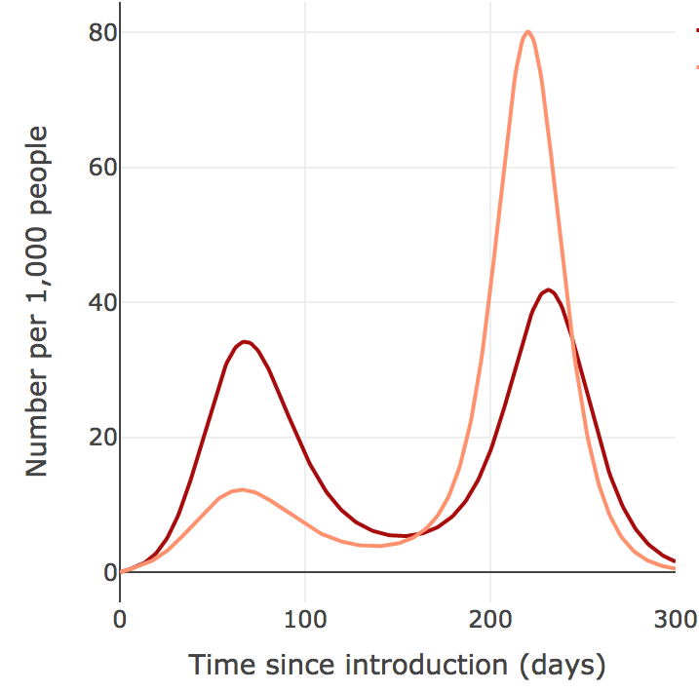
Will the summer save us?
No.
Seasonality
Could even
Lead to a bigger
Second wave
Alison Hill et al.
Notes:
Here’s how I think about social distancing—many of us clumped in our homes, some still going out

Slide 24
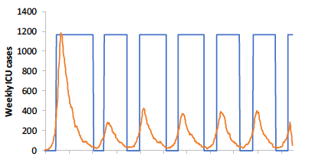
If we manage to stop it is it going to come back?
Yes.
The flattened curve is going to be a bumpy ride. #pumpthebrakes
The axis depends on how we social distance
Ferguson et al. a couple weeks ago
Notes:
Here’s how I think about social distancing—many of us clumped in our homes, some still going out

Slide 25
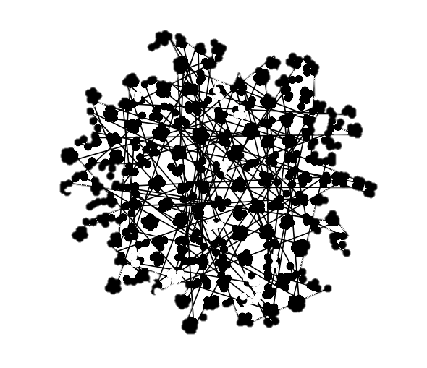
If we manage to stop it is it going to come back?
At some point we will turn increasingly to metapopulation models.
We can’t keep the virus out by screening at borders.
Where will we draw the lines? Will movement be restricted between states? counties? Neighborhoods?
Gostic et al https://lloyd-smithlab.shinyapps.io/travelScreeningModel/
Notes:
Here’s how I think about social distancing—many of us clumped in our homes, some still going out

Slide 26
Epidemiology of SARS-CoV-2 Infection
Michael Z. Levy
Associate Professor Dept. of Biostatistics, Epidemiology & Informatics
University of Pennsylvania
mzlevy@upenn.edu

